Slide 1
Welcome Miquella de Boer, Premier Field Engineer

Slide 2
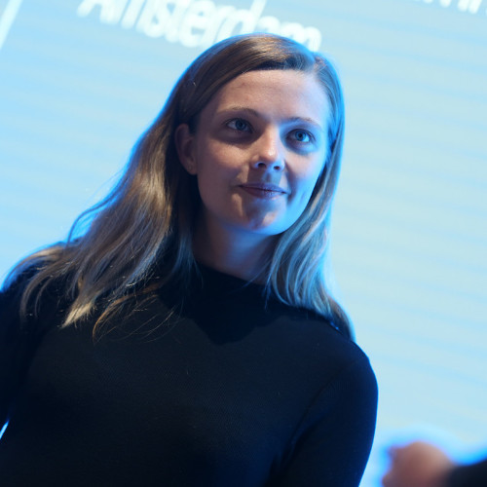
Welcome
Miquella de Boer
Premier Field Engineer

Slide 3
Welcome
Miquella de Boer
Premier Field Engineer
Data Scientist

Slide 4
Welcome
Miquella de Boer
Premier Field Engineer
Data Scientist
DevOps and ML Engineer

Slide 5
Agenda Day 1
Morning: Platform Introduction
Introduction to the AI Platform
Azure Machine Learning conceptually
Azure Machine Learning workspaces
Azure Machine Learning tools and interfaces
Afternoon: Running Experiments
Experiment Tracking
Unattended Remote Execution (parallel)
Hyperparameter tuning

Slide 6
Agenda Day 2
Morning: Remote Compute
Afternoon: Datastore/ Datasets
Datasets
Event-based triggering of ML workflows
Digital Audit Trail
Labelling

Slide 7
Agenda Day 3
Morning: Pipelines
Pipelines conceptually
Pipeline Experiments
Publishing pipelines
Afternoon: Model Management/deployment
Artifact Store
Model CI/CD

Slide 8
Introductions
Name?
Department?
Role and typical job activities / projects?
Learning goal for the three days?
Biggest challenge while doing data science?

Slide 9
Logistics
Monday, Tuesday, Wednesday
Time: 10h – 16h
Lunch time? Breaks?
10 min break every 50 min (from 10.50-11.00 ect.)
Lunch 12.00 -13.00
Important calls or emails? No problem. Questions? Please raise!

